Slide 1
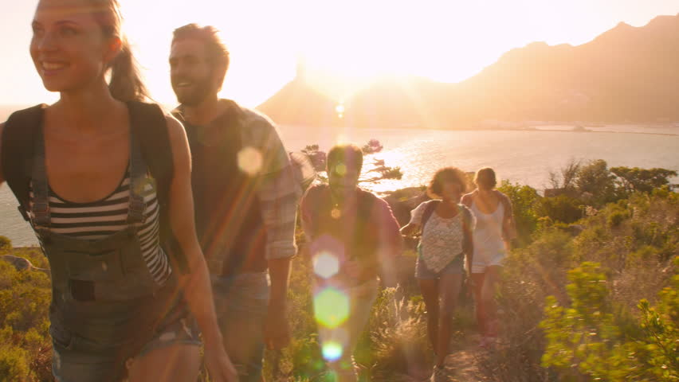
The Dream, the Plan, the Path
European Laudato Si’ Alliance
Télos and techné of living within planetary boundaries: role of the Church
Fr. Augusto Zampini
27 May 2021

Slide 2
Time to see Rotten roots = Rotten fruits
COVID-19 Crisis
Political & economic crisis
Ecological Crisis
Extractivist & technocratic mentality
Broken world & globalisation of indifference
Consumerists & throwaway culture

Slide 3
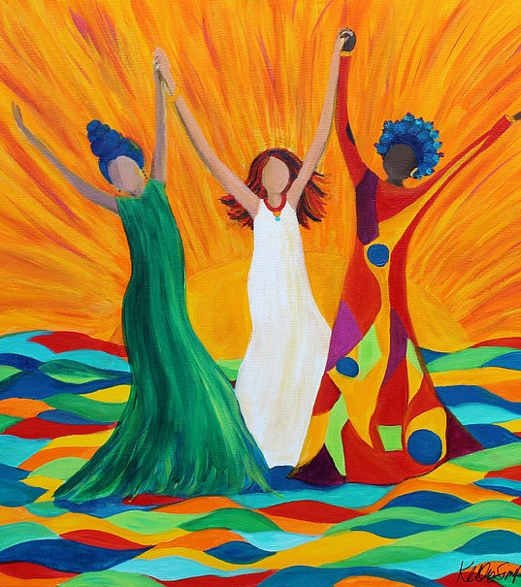
Time for hope “Restore HOPE and bring about renewal” (FT, 30)

Slide 4
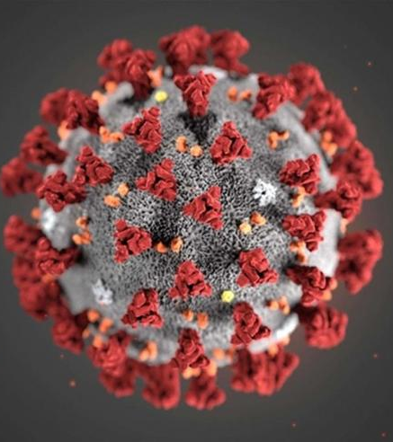
Time to choose COVID-19 pandemic as an opportunity to create something new

Slide 5
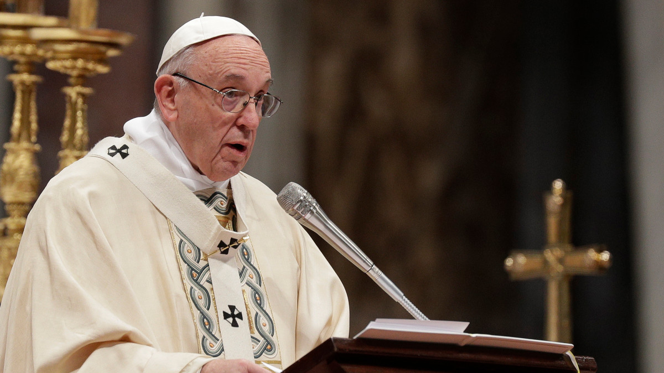
Time for dreams
“Hope is audacious, and so, let us encourage one another to dream big. Brothers and sisters, let us learn to dream big!”
- Pope Francis, General Audience, September 23rd 2020

Slide 6
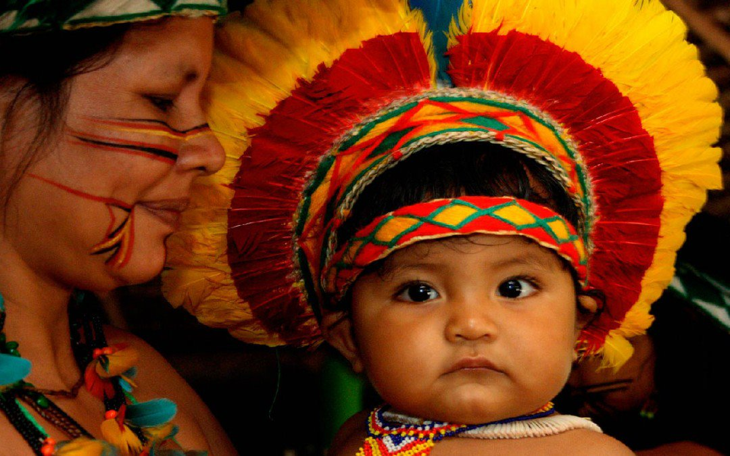
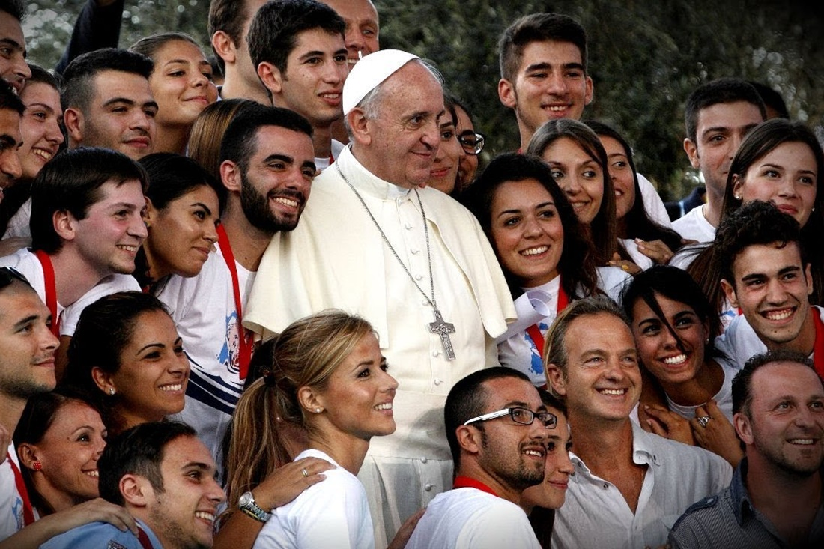
Cultural Dream
Social Dream
The Dream
Pope Francis & Querida Amazonia
Ecological Dream
Ecclesial Dream

Slide 7
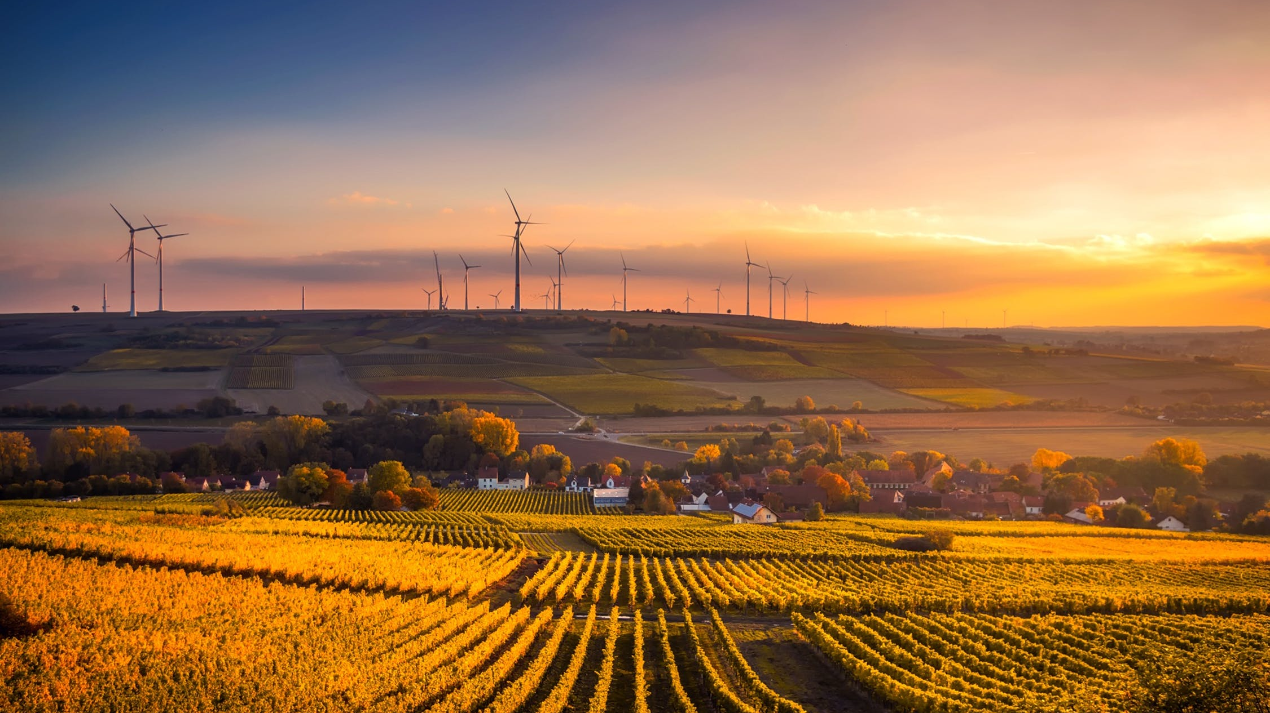
Time to act: Telos for living within planetary boundaries
Caring for our common home as an essential component of faith: “It is good for humanity and the world at large when we believers better recognize the ecological commitments which stem from our convictions” (Laudato Si’, 64)
Care for our brothers and sisters as an essential component of faith: “All of us have a responsibility for the wounded, those of our own people and all the peoples of the earth. Let us care for the needs of every man and woman, young and old, with the same fraternal spirit of care and closeness that marked the Good Samaritan” (Fratelli Tutti, 79)
Caring for future generations as an essential component of faith: “An authentic faith […] always involves a deep desire to change the world, to transmit values, to leave this earth somehow better that we found it.” (Evangelii Gaudium, 183)

Slide 8
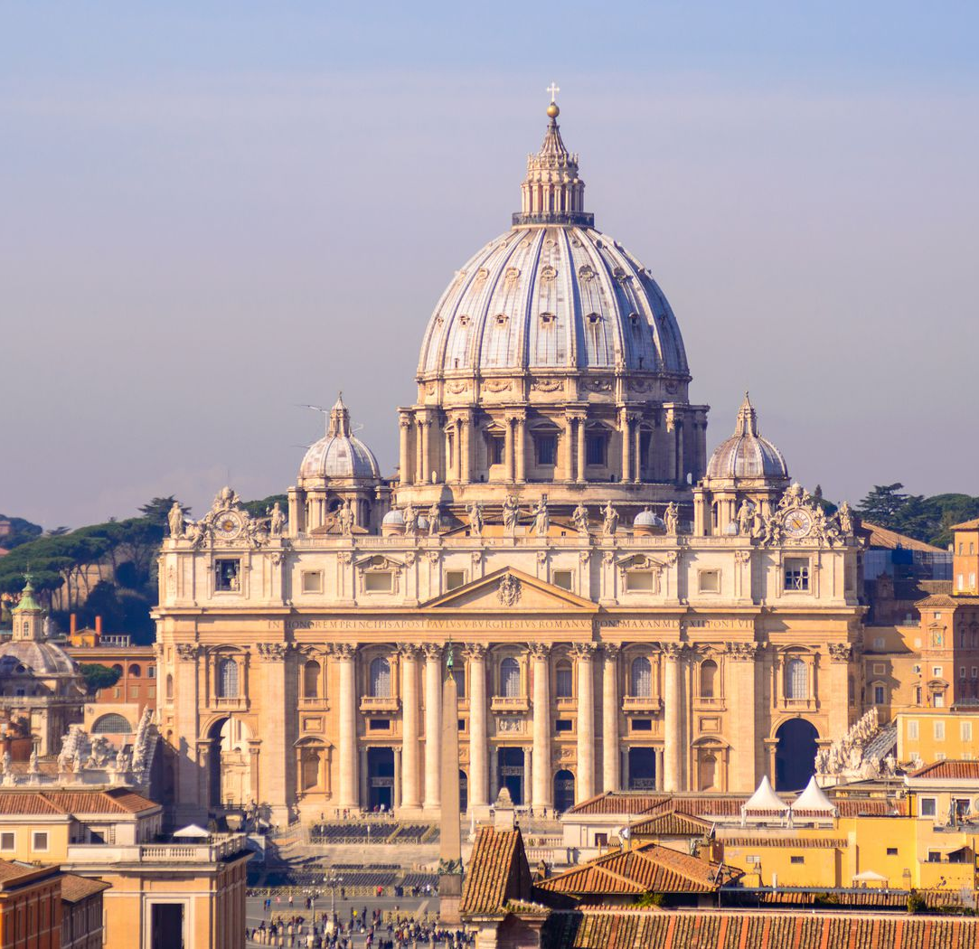
Church that goes forth
“Rich soil” (Mk 4:8): working in synodality to listen, connect, inspire
“New wine, new skins” (Mk 2:22): addressing new problems with new solutions
Pilgrims who, can transcend and open ourselves up to a new horizon

Slide 9
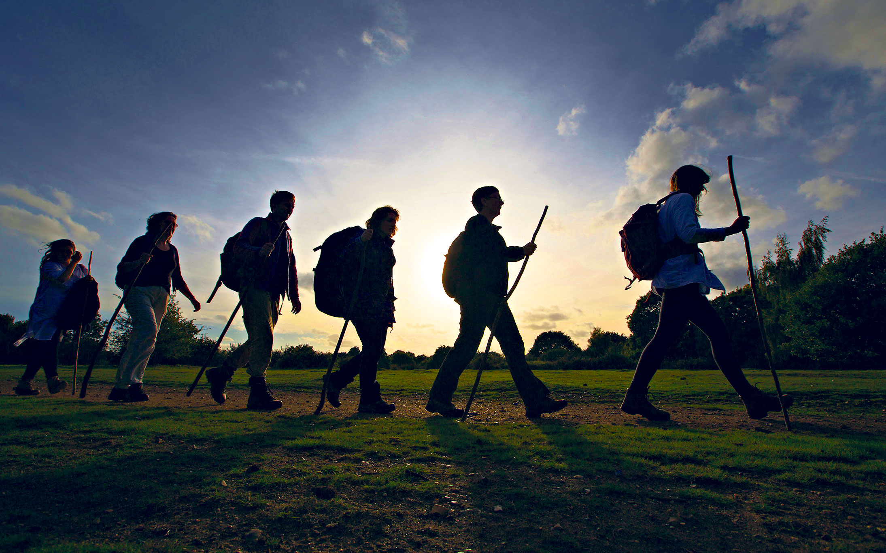
Integral Ecology & the Decade of Action
Preferential option for the poor
New universal solidarity / universal fraternity
Care for our common home

Slide 10
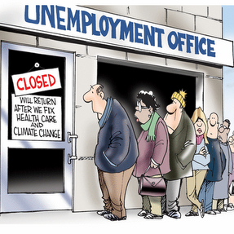
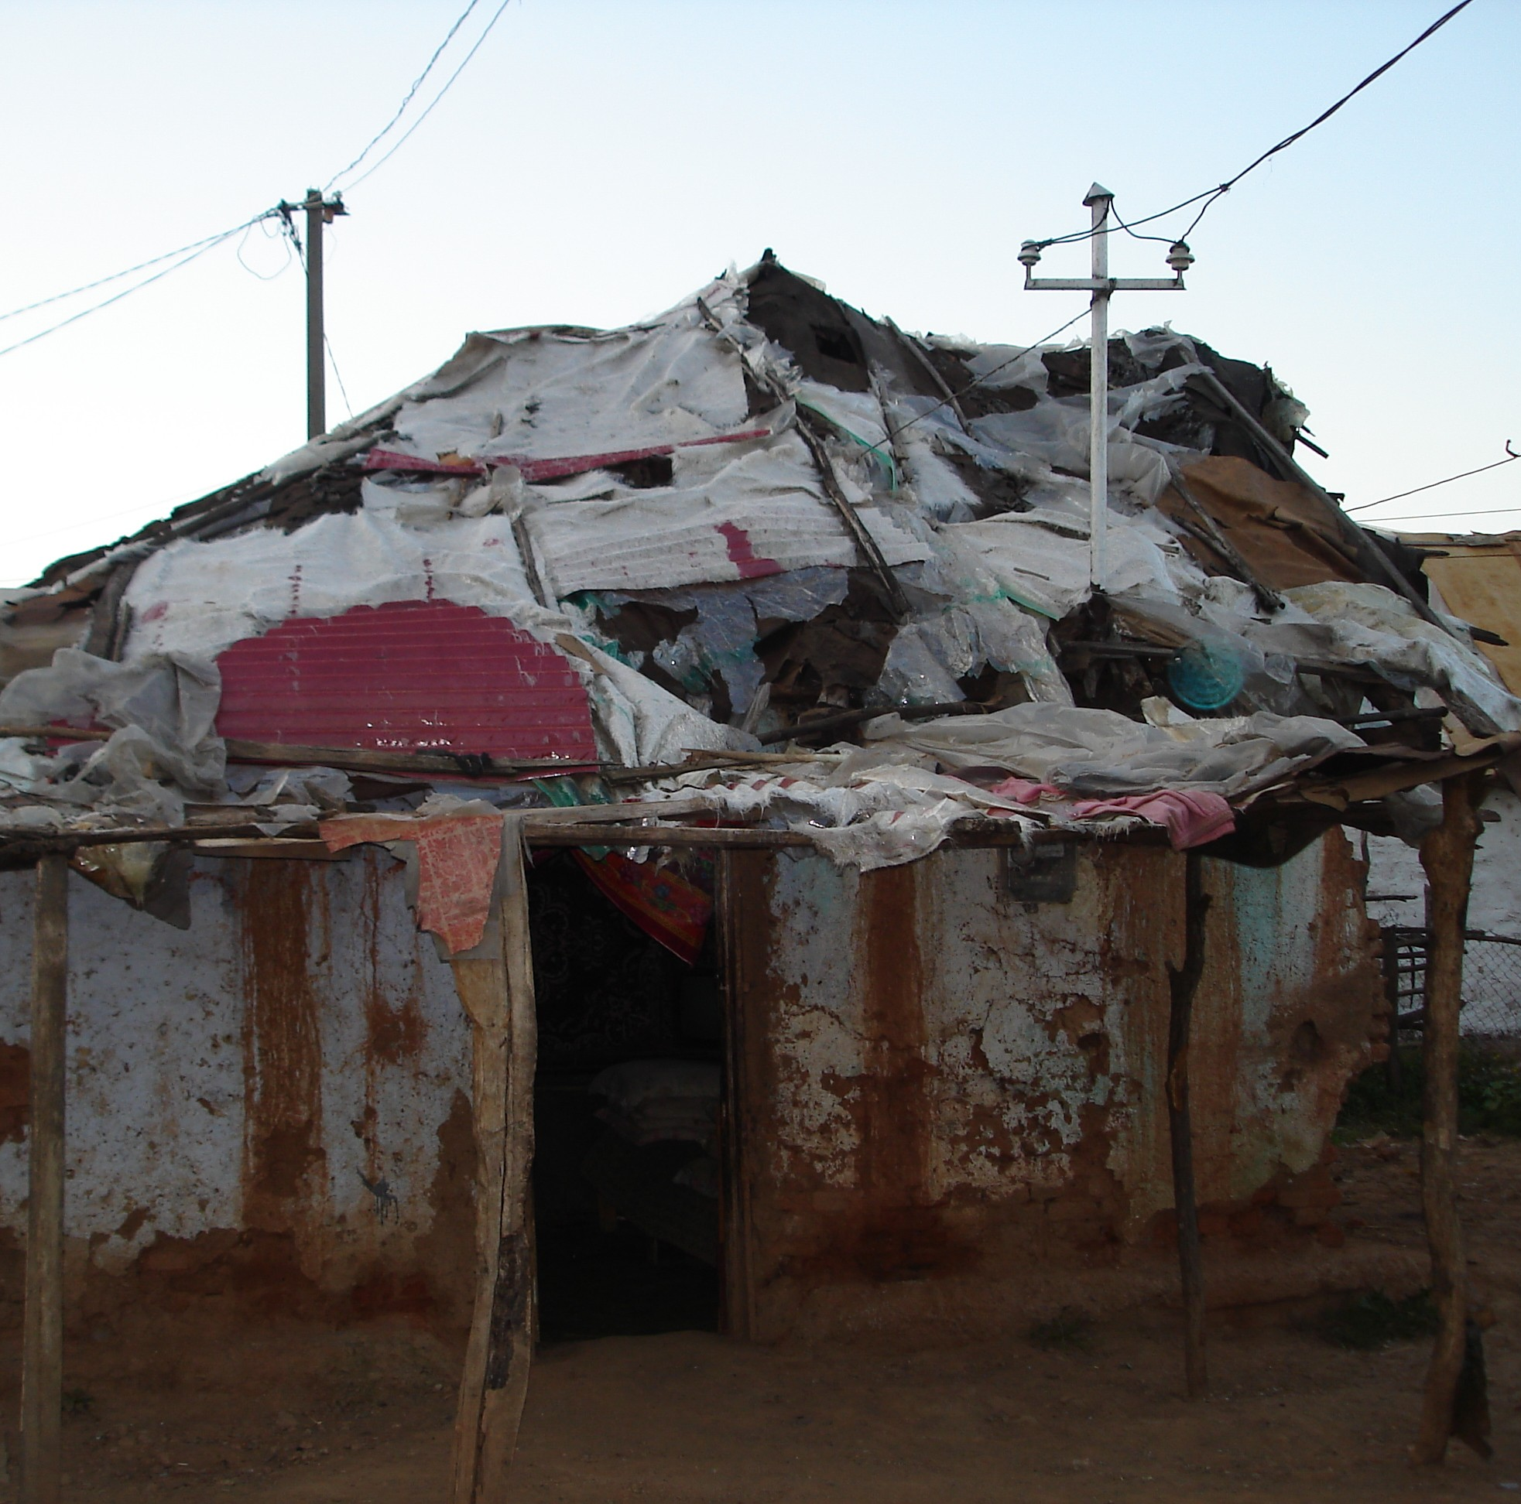
Land – Labour – Livelihood (TTT)

Slide 11
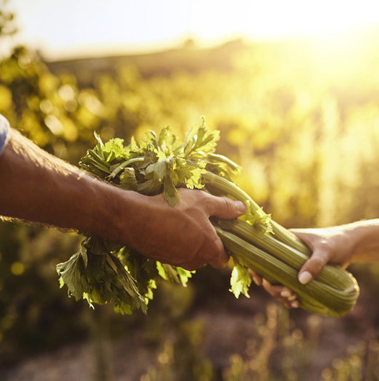
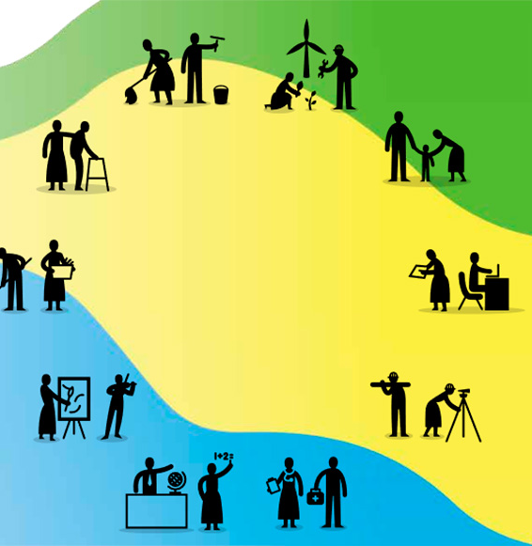
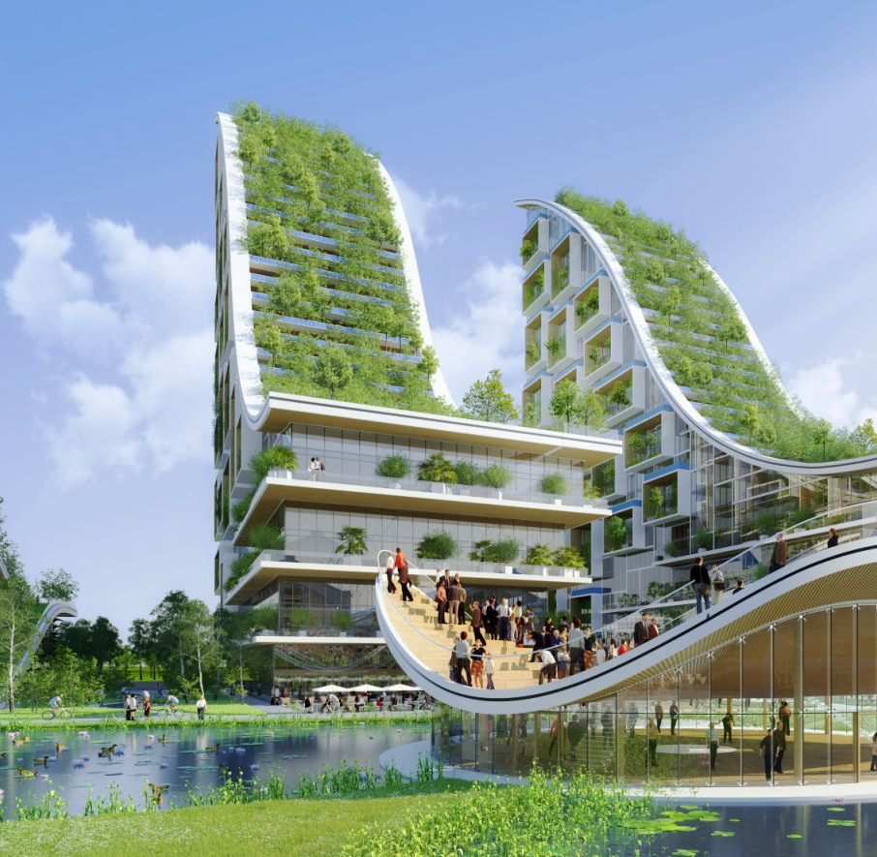
Land – Labour – Livelihood (TTT) Finance & technology - accelerating care Culture & politics - rebalancing social systems with ecosystems Faith institutions - aspiring to to be more (healthy & salvation)

Slide 12
Time to walk together Role of the Church in making the (community) dream a reality (cf FT, 8)
Promoting spirituality as a driver for radical change
Walking with others in synodality
Encouraging a new imagination of the possible with the realism that only the Gospel can give
Aiming at regenerating society, the economy included - Preparing the future

Slide 13
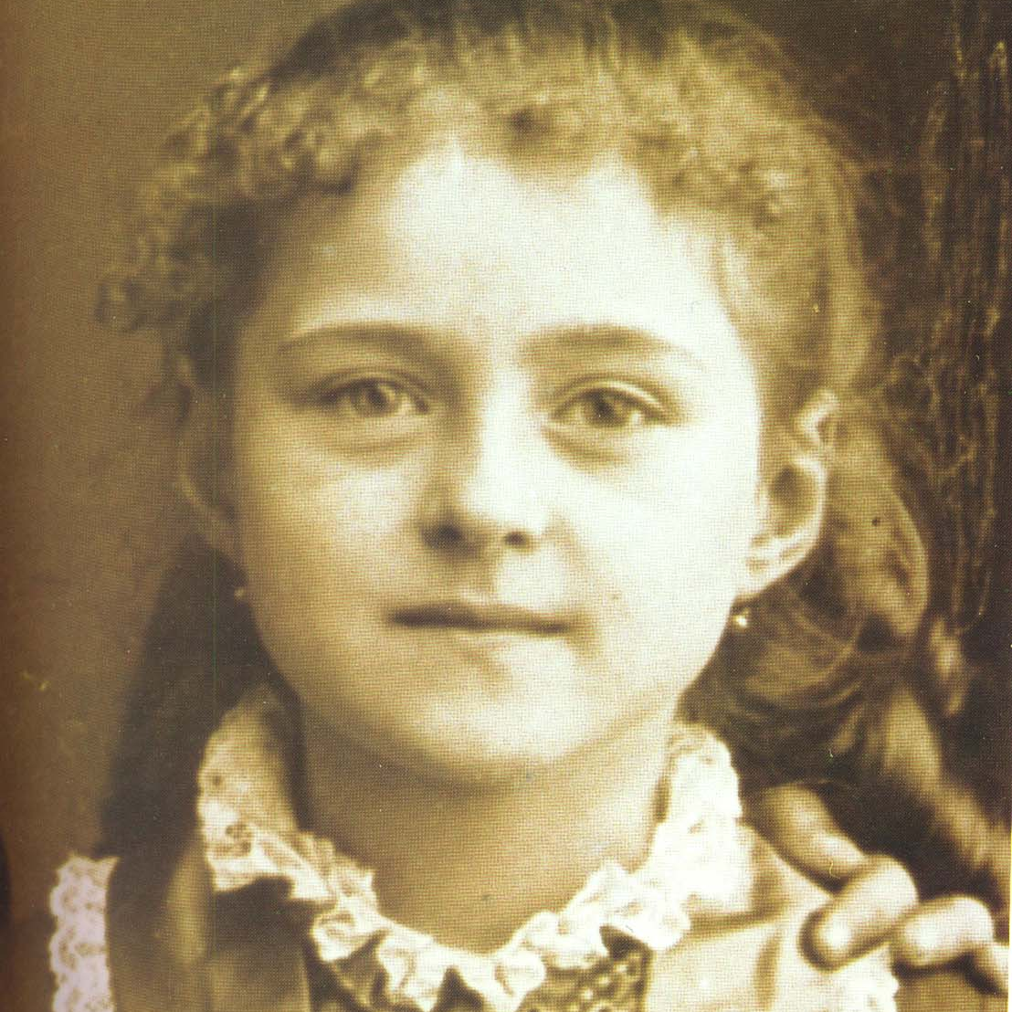
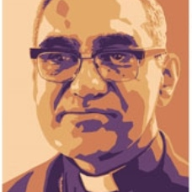
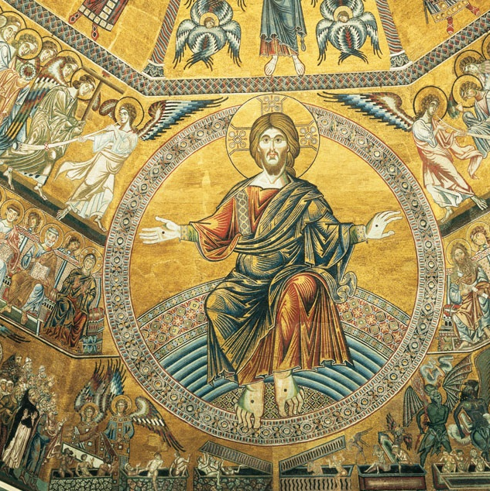
Personal & Social love telos & techné

